Slide 1
Session 1
Introduction

Slide 2
Goals for the course
That you change the world.
Which you can only do if you keep yourself safe

Slide 3
How will we know if the course is going well
More people in the class next week than this week.
Invited back
To bigger audience
Lots of questions

Slide 4
Content Warnings
This course contains:
Examples of harm done to people fighting for change
Examples of the harm that they are fighting against.
Examples can be adapted if we are given some prior notice.

Slide 5
Topics for the session
Phone vs safe
Security vs Usefulness
Types of change
Different ways to achieve change

Slide 6
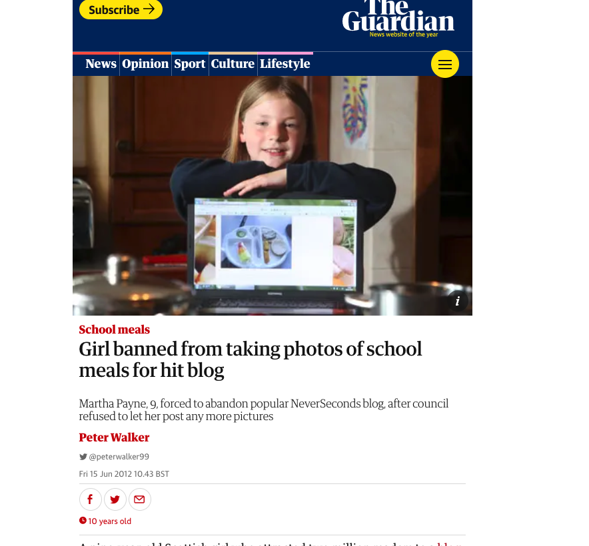
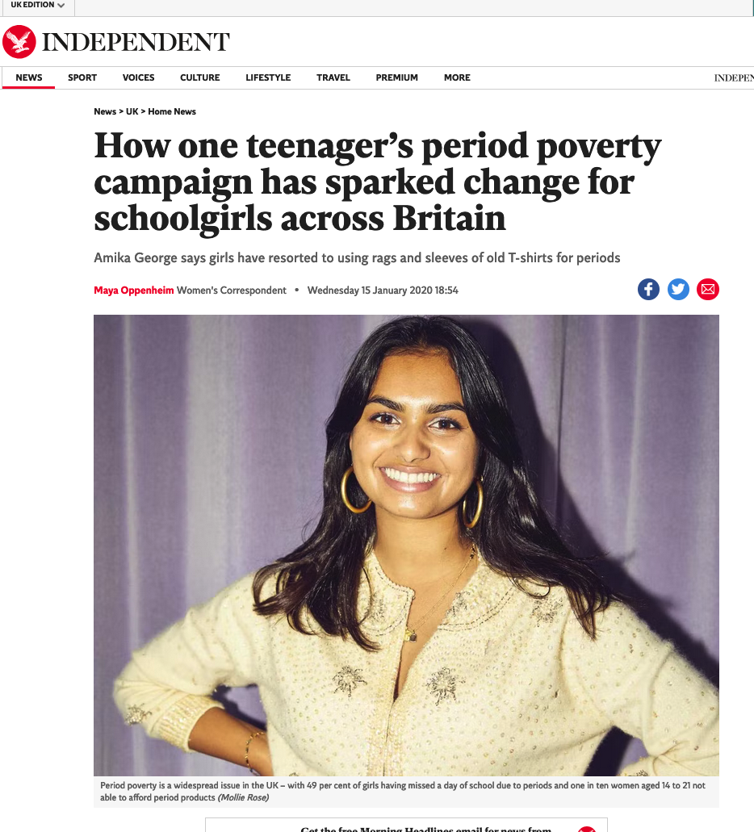

Slide 7
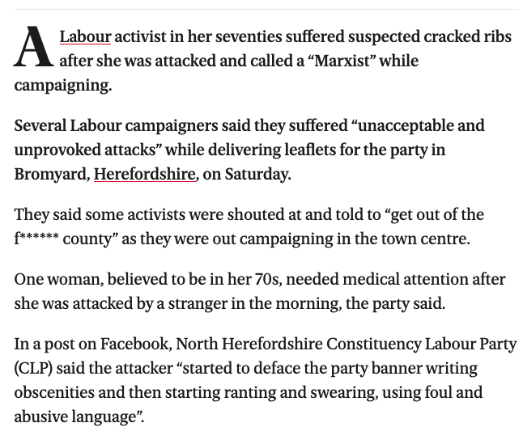
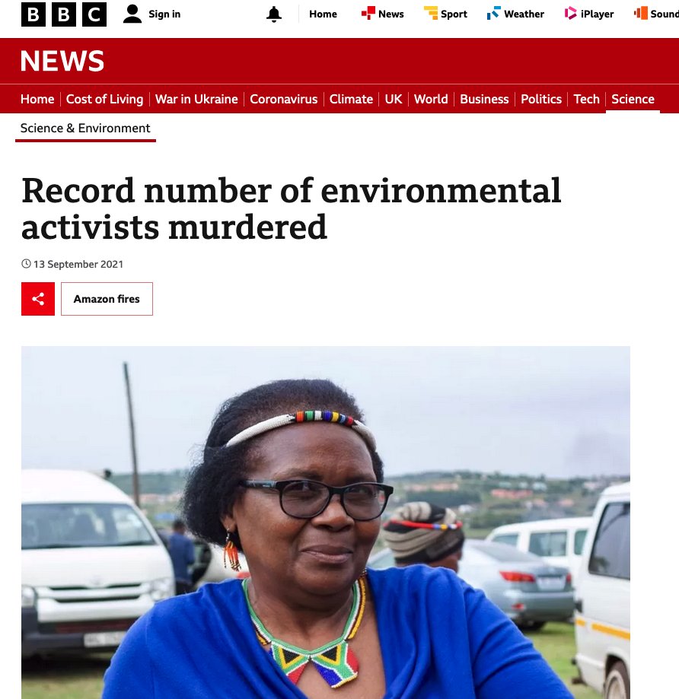
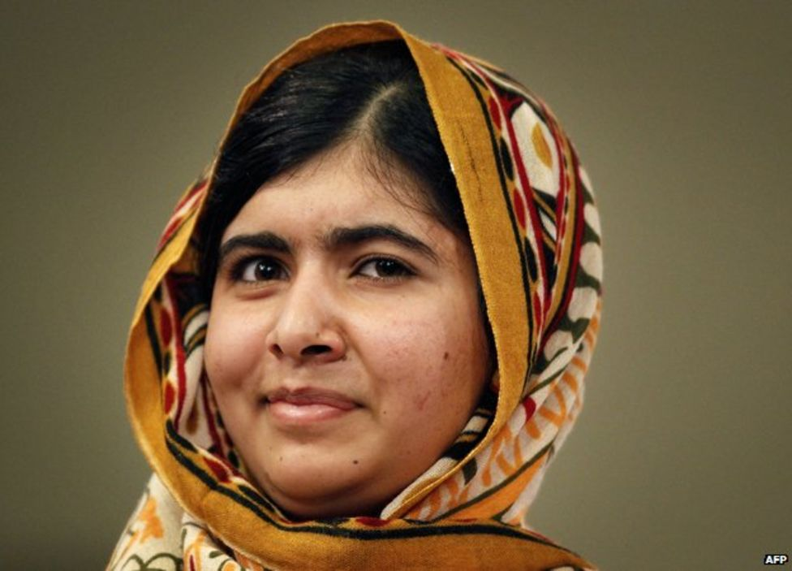
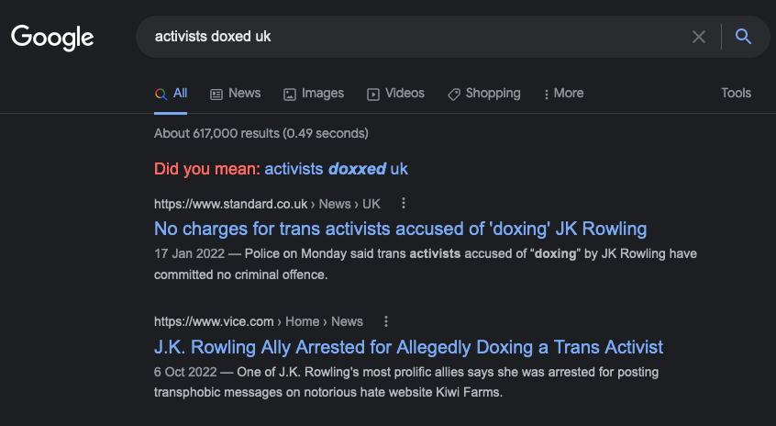

Slide 8
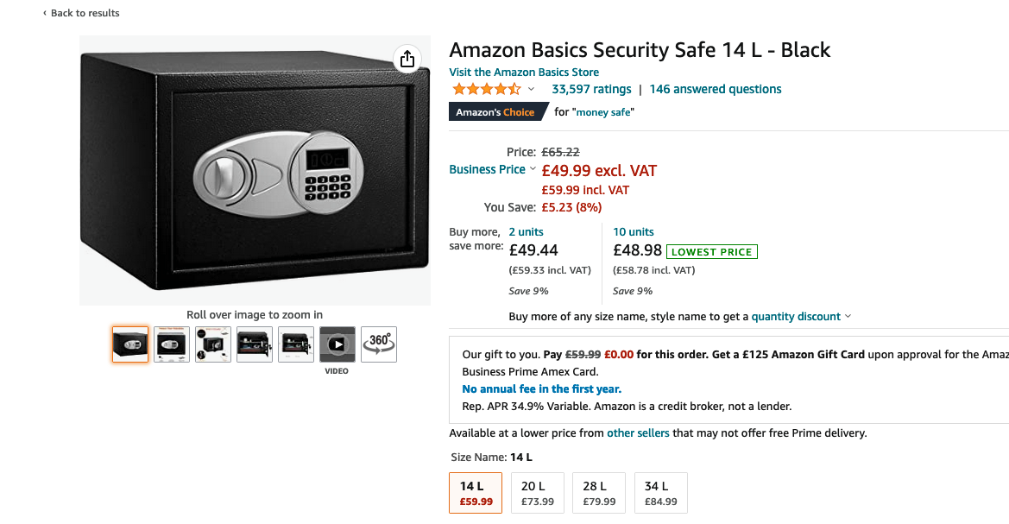
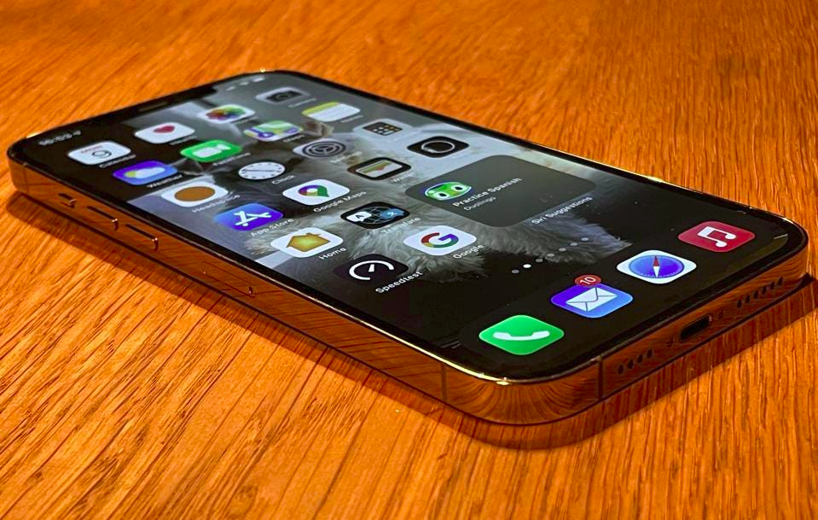
Starting with Security
You are sharing resources with a group of people who are very ashamed of a particular condition. The list of people and their contact information must remain private. Which is the best place to store it?

Slide 9
How many of these did we get?

Slide 10
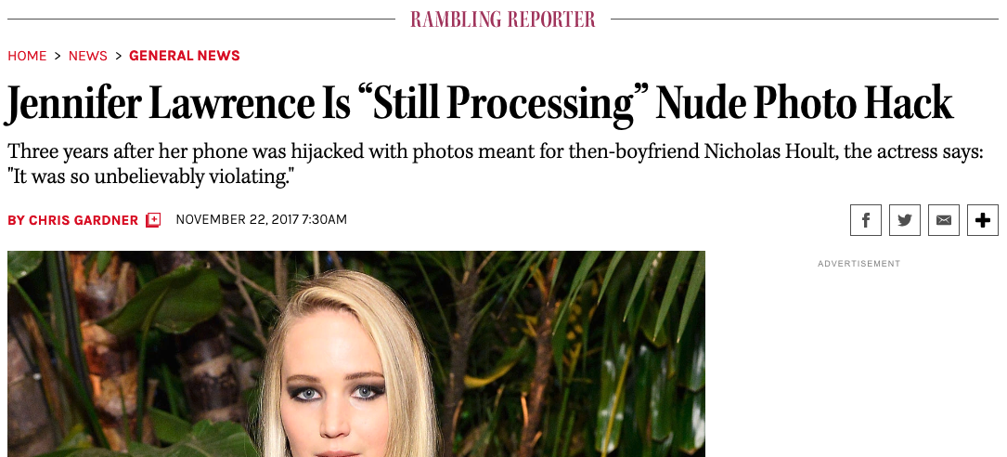
The phone is not secure

Slide 11
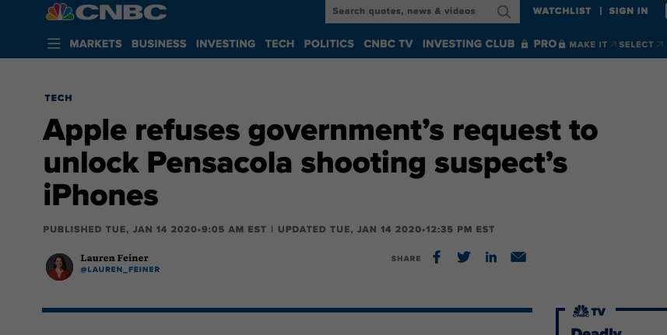
The phone is very secure

Slide 12
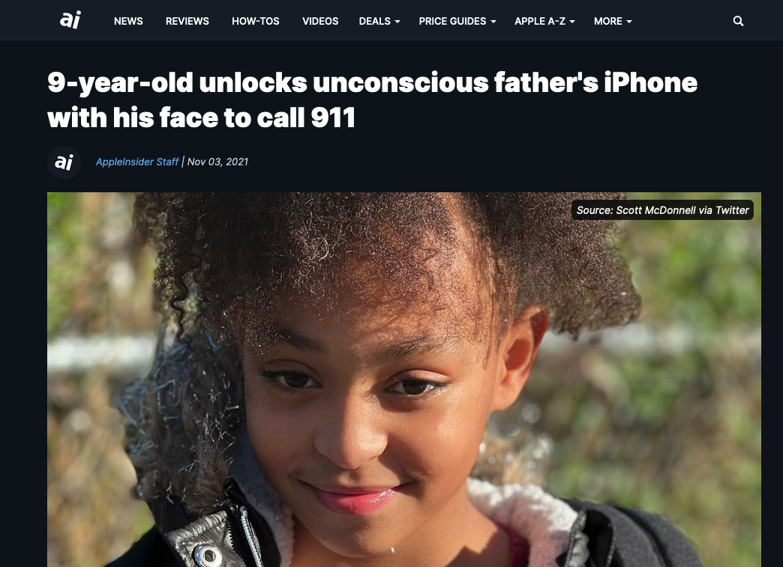
What security is on the phone?

Slide 13
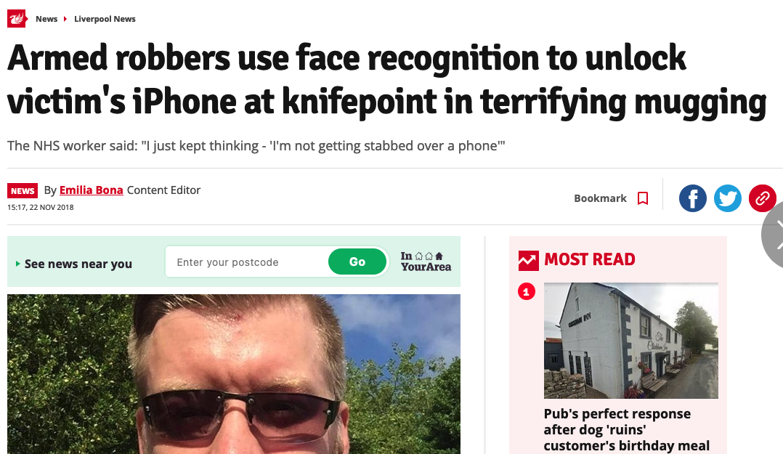
What Security is on the phone 2

Slide 14
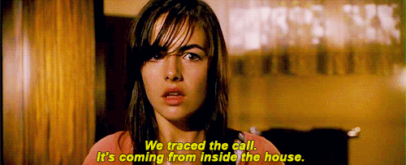
What if the attacker is in the house?

Slide 15
Other things that might have come up
Attacker’s motivations: what if they are trying to destroy rather than take?
Defender’s motivations: what if they are prepared to destroy rather than lose?
Do you want to be able to deny it?
What if we put the phone *in* the safe?
How often do you need to use the information?
Attackers capabilities?
Let’s watch a video: https://www.youtube.com/watch?v=RkdJti43IgU

Slide 16
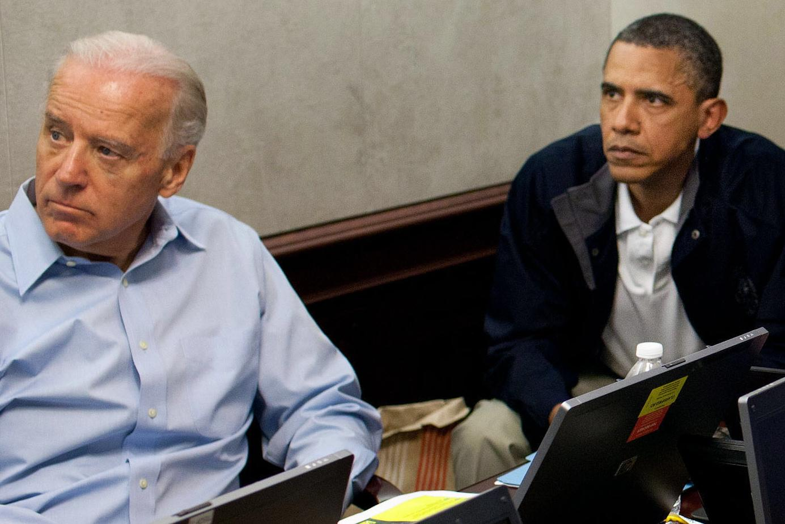
You secure by making things hard to use…

Slide 17
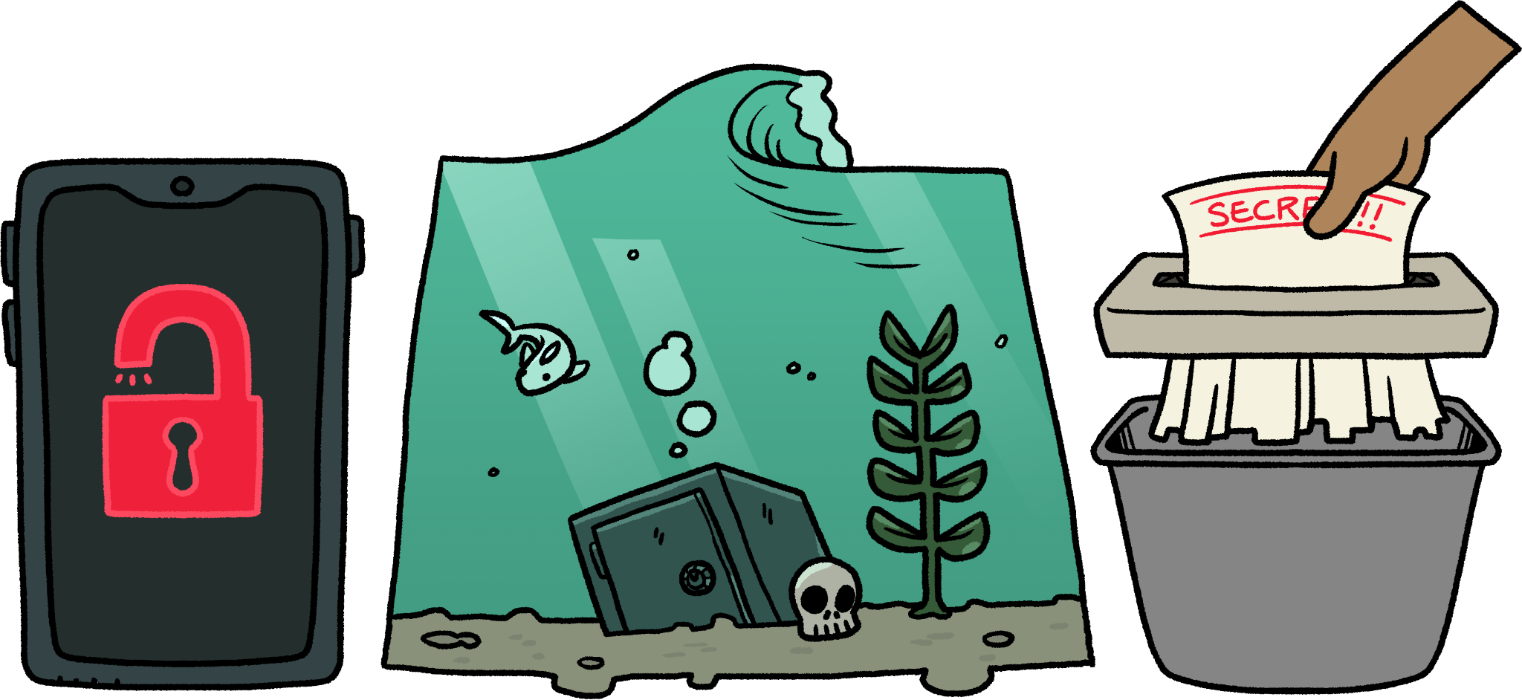
What did we learn?
Things aren’t secure or not - their security varies depending on lots of factors.
Some things that are secure to you aren’t secure to me and vice-versa.
Making things secure makes them harder to use
If you don’t know the information in the first place, then you can’t lose it.

Slide 18
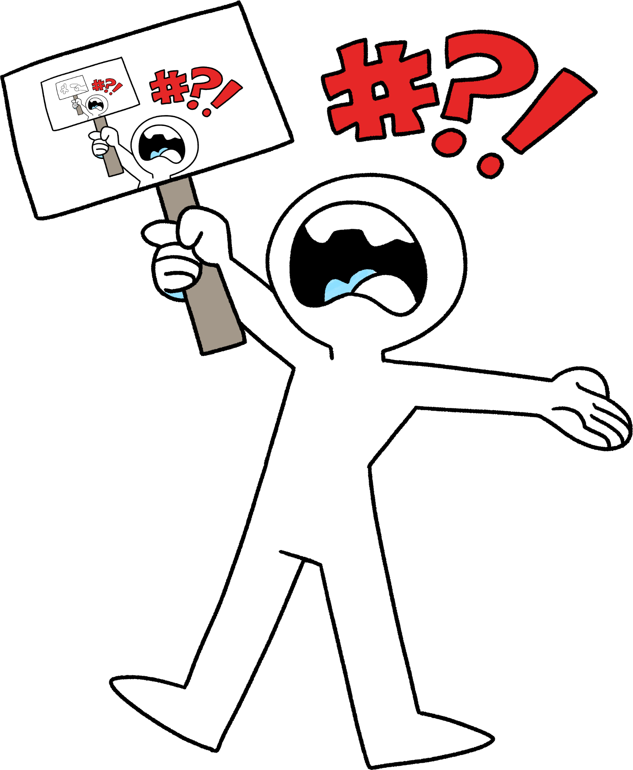
Social Change
What annoys me?
People driving too close to me
Postcode lotteries for disability devices
Politicians not citing their sources.
People not cleaning up after their dogs
What annoys you?

Slide 19
How do people make change happen?

Slide 20
How do people make change happen?
Directly asking
Literally just asking
Official complaints
Letters to people with the power to make changes or advocate
Knowing what they want
Doing it yourself
Getting the information and building support
Freedom of information
Talking to journalists
Social media
Making life difficult
Protests
Boycotts
Strikes

Slide 21
How do people make change happen?
Which of the things on the left of the whiteboard match the things on the right of the whiteboard?

Slide 22
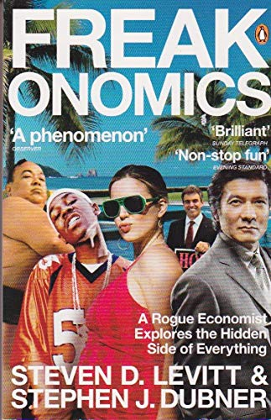
Further Reading
Bruce Snider’s blog: https://www.schneier.com/
Loadsamoney by Stephen Jory
Freakonomics by Stephen J. Dubner and Steven Levitt

Slide 23
Summary
It’s hard to manage change and risk at the same time.
Things aren’t ‘secure’ or ‘insecure’ - it has to be a sentence “This is secure against someone who doesn’t want to use violence or be caught”
The more secure something is the harder it is to use.
The changes you make can be very big or very small.
Different changes need different approaches

Slide 24
Next Session…
Information

